Slide 1
PAGE LAYOUT WITH CSS

Slide 2
Overview
2
◻◻ Styling Page Sections
◻◻ Introduction to Layout
◻◻ Floating Elements
◻◻ Sizing & Positioning

Slide 3

Styling Page Sections
3

Slide 4
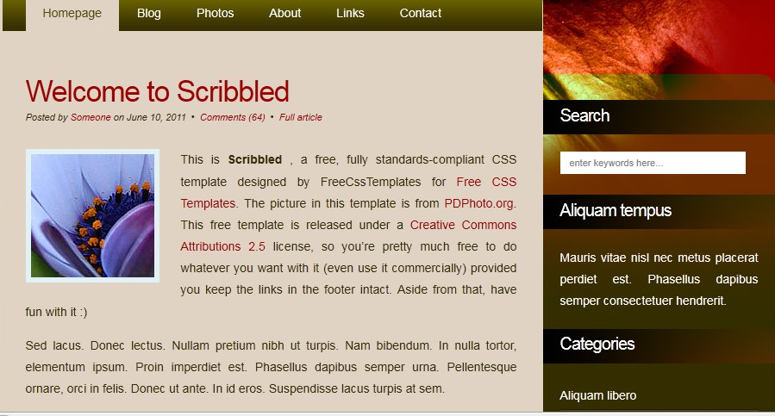
Why do we need page sections?
4
◻ Style individual elements, groups of elements, sections of text or of the page
◻ Create complex page layouts

Slide 5
Sections of a page <div>
5
<div class="shout">
<h2>Coding Horror! Coding Horror!</h2>
<p class="special">See our special deal on Droids!</p>
<p>We'll beat any advertised price!</p>
</div> HTML
Coding Horror! Coding Horror!
See our special deal on Droids!
We’ll beat any advertised price! output
◻ Tag used to indicate a logical section or area of a page
◻ Has no appearance by default, but you can apply styles to it

Slide 6
Inline Sections <span>
6
<h2>Coding Horror! Coding Horror!</h2>
<p>See our <span class="special“>spectacular</span> deal on Droids!</p>
<p>We'll beat <span class="shout“> any advertised price</
span>!</p>
HTML
Coding Horror! Coding Horror!
See our deal on Droids! We’ll beat any advertised price!
spectacular
output
◻ has no onscreen appearance, but you can apply a style or ID to it, which will be applied to the text inside the span

Slide 7
CSS context selectors
7
selector1 selector2 { properties
}
CSS
◻◻ applies the given properties to selector2 only if it is inside a
selector1 on the page
selector1 > selector2 { properties
}
CSS
◻◻ applies the given properties to selector2 only if it is directly inside a selector1 on the page

Slide 8
Context selector example
8
<p>Eat at <strong>Greasy's Burger</strong>...</p>
<ul>
<li>The <strong>greasiest</strong> burgers in town!</li>
<li>Yummy and greasy at the same time!</li>
</ul>
HTML
li strong { text-decoration: underline; }
CSS
Eat at Greasy’s Burger…
The greasiest burgers in town!
Yummy and greasy at the same time!
output

Slide 9
More complex example
9
<div id="ad">
<p>Eat at <strong>Greasy's Burger</strong>...</p>
<ul>
<li class="important">The <strong>greasiest</strong> burgers in town!</li>
<li>Yummy and <strong>greasy at the same time </strong>!</li>
</ul>
</div>
HTML
#ad li.important strong { text-decoration: underline; }
CSS
Eat at Greasy’s Burger…
The greasiest burgers in town!
Yummy and greasy at the same time!
output

Slide 10
Introduction to Layout
10

Slide 11
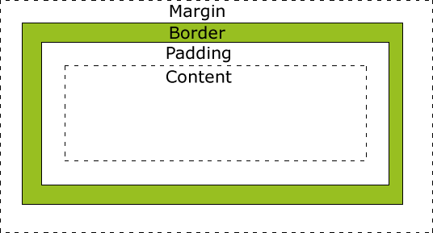
The CSS Box Model
11
◻◻ Every element composed of:
¤ content
¤ a border around the element
¤ padding between the content and the border
¤ a margin between the border and other content

Slide 12
The CSS Box Model (cont.)
12
width = content width + L/R padding + L/R border + L/R margin
height = content height + T/B padding + T/B border + T/B margin

Slide 13
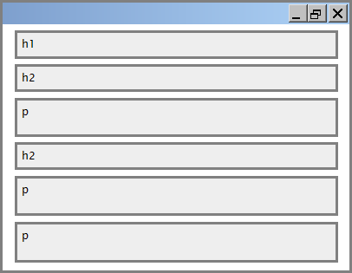
Document Flow – block elements
13

Slide 14
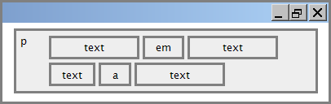
Document flow - inline elements
14

Slide 15
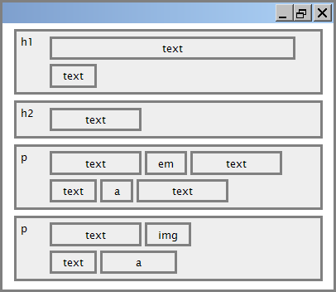
Document flow - a larger example
15

Slide 16
CSS properties for borders
16
h2 { border: 5px solid red; }
CSS
This is a heading.
output
property | description
border | thickness/style/size of border on all 4 sides
◻◻ Thickness: px, pt, em, or thin, medium, thick
◻◻ Style: none, hidden, dotted, dashed, double, groove, inset, outset, ridge, solid
◻◻ color

Slide 17
More border properties
17
property | description
border-color, border-width, border-style | specific properties of border on all 4 sides
border-bottom, border-left, border-right, border-top | all properties of border on a particular side
border-bottom-color, border-bottom- style, border-bottom-width, border-left- color, border-left-style, border-left-width, border-right-color, border-right-style, border-right-width, border-top-color, border-top-style, border-top-width | properties of border on a particular side
Complete list of border properties http://www.w3schools.com/css/ css_border.asp

Slide 18
Another border example
18
h2 {
border-left: thick dotted #CC0088;
border-bottom-color: rgb(0, 128, 128); border-bottom-style: double;
}
CSS
This is a heading.
output
◻◻ each side's border properties can be set individually
◻◻ if you omit some properties, they receive default

Slide 19
CSS properties for padding
19
property | description
padding | padding on all 4 sides
padding-bottom | padding on bottom side only
padding-left | padding on left side only
padding-right | padding on right side only
padding-top | padding on top side only
Complete list of padding properties http://www.w3schools.com/css/css_padding.asp

Slide 20
Padding example 1
20
p { padding: 20px; border: 3px solid black; } h2 { padding: 0px; background-color: yellow; }
CSS
This is a first paragraph.
This is a second paragraph.
This is a heading
output

Slide 21
Padding example 2
21
p {
padding-left: 200px; padding-top: 30px;
background-color: fuchsia;
}
CSS
output
This is a first paragraph
This is a first paragraph.
This is a second paragraph
◻◻ each side's padding can be set individually
◻◻ notice that padding shares the background color of the element

Slide 22
CSS properties for margins
22
property | description
margin | margin on all 4 sides
margin-bottom | margin on bottom side only
margin-left | margin on left side only
margin-right | margin on right side only
margin-top | margin on top side only
Complete list of margin properties http://www.w3schools.com/css/css_margin.asp

Slide 23
Margin example 1
23
p {
margin: 50px;
background-color: fuchsia;
}
CSS
output
This is a first paragraph
This is a second paragraph
◻◻ notice that margins are always transparent

Slide 24
Margin example 2
24
p {
margin-left: 8em; background-color: fuchsia;
}
CSS
output
This is a first paragraph
This is a second paragraph
◻◻ each side's margin can be set individually

Slide 25
CSS properties for dimensions
25
p { width: 350px; background-color: yellow; } h2 { width: 50%; background-color: aqua; }
CSS
output
This paragraph uses the first style above
An h2 heading
property | description
width, height | how wide or tall to make this element (block elements only)
max-width, max-height, min-width, min-height | max/min size of this element in given dimension

Slide 26
Floating Elements
26

Slide 27

The CSS float property
27
img.headericon {
float: right; width: 130px;
}
CSS
Ghostbusters is a 1984 American science fiction comedy film written by co-stars Dan Aykroyd and Harold Ramis about three eccentric New York City
parapsychologists-turned-ghost capturers.
output
property | description
float | side to hover on; can be left, right, or none (default)
removed from normal document flow; underlying text wraps around as necessary

Slide 28
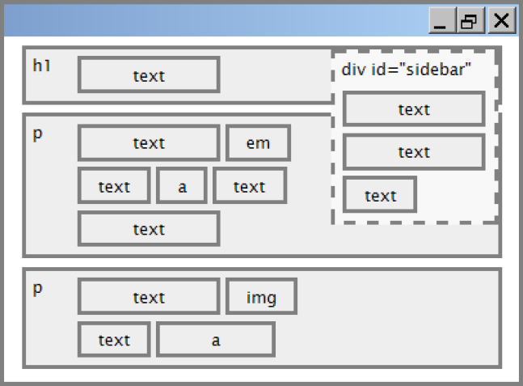
Floating elements diagram
28

Slide 29
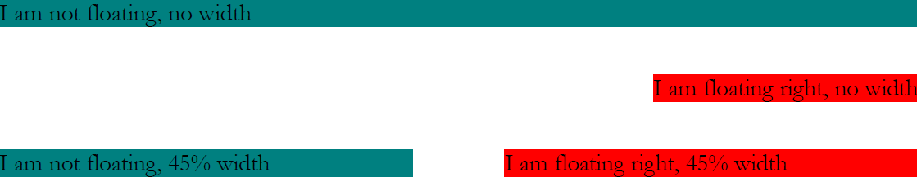
Common float bug: missing width
29
◻◻ often floating block elements must have a width property value

Slide 30

The clear property
30
p { background-color: fuchsia; }
h2 { clear: right; background-color: yellow; }
CSS
Mario is a fictional character in his video game series. Serving as Nintendo's mascot and the main protagonist of the series, Mario has appeared in over 200 video games since his creation
Super Mario Fan Site!
output
Mario is a fictional character in his video game series.
Serving as Nintendo's mascot and the main protagonist of the series, Mario has appeared in over 200 video games since his creation.

Slide 31
The clear property (cont.)
31
property | description
clear | disallows floating elements from overlapping this element; can be left, right, or none (default)

Slide 32
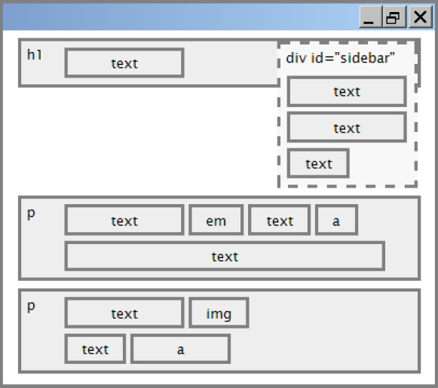
Clear diagram
32
div#sidebar { float: right; } p { clear: right; }
CSS

Slide 33
Common error: container too short
33
<p><img src="images/mario.png" alt=“super mario" /> Mario is a fictional character in his video game series.....</p>
HTML
p { border: 2px dashed black; } img { float: right; }
CSS
Mario is a fictional character in his video game series. Serving as Nintendo's mascot and the main protagonist of the series, Mario has appeared in over 200 video games since his creation.
output

Slide 34
The overflow property
34
p { border: 2px dashed black; overflow: hidden; }
CSS
Mario is a fictional character in his video game series. Serving as Nintendo's mascot and the main protagonist of the series, Mario has appeared in over 200 video games since his creation.
output

Slide 35
The overflow property (cont.)
35
property | description
overflow | specifies what to do if an element's content is too large; can be auto, visible, hidden, or scroll

Slide 36
Multi-column layouts
36
<div>
<p>first paragraph</p>
<p>second paragraph</p>
<p>third paragraph</p>
Some other text that is important
</div> HTML
p { float: right; width: 25%; margin: 0.5em; border: 2px solid black; }
div { border: 3px dotted green; overflow: hidden; }
CSS
Some other text that is important
third paragraph |  | second paragraph |  | first paragraph
output

Slide 37
Sizing and Positioning
37

Slide 38
The position property (examples)
38
div#ad {
position: fixed;
right: 10%;
top: 45%;
}
CSS
property | value | description
position | static | default position
 | relative | offset from its normal static position
 | absolute | a fixed position within its containing element
 | fixed | a fixed position within the browser window
top, bottom, left, right | positions of box's corners

Slide 39
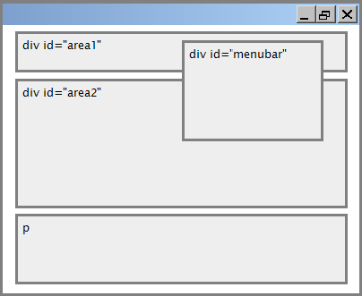
Absolute positioning
39
#menubar { position: absolute; left: 400px;
top: 50px;
}
CSS
◻◻ removed from normal flow
◻◻ positioned relative to the block element containing them
◻◻ actual position determined by
top, bottom, left, right
◻◻ should often specify a width
property as well

Slide 40
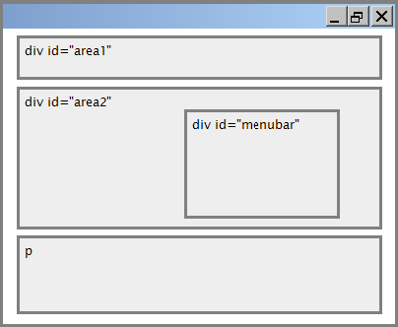
Relative positioning
40
#area2 { position: relative; }
CSS
◻◻ absolute-positioned elements are normally positioned at an offset from the corner of the overall web page
◻◻ to make the absolute element to position itself relative to some other element's corner, wrap the absolute element in an element whose position is relative

Slide 41
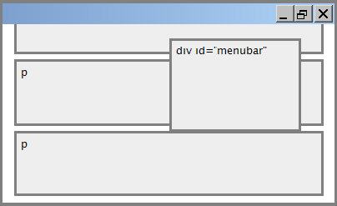
Fixed positioning
41
#menubar { position: fixed; left: 400px; top: 50px;
}
CSS
◻◻ removed from normal flow
◻◻ positioned relative to the browser window even when the user scrolls the window, element will remain in the same place

Slide 42
Alignment vs. float vs. position
42
◻◻ If possible, lay out an element by aligning its content
¤ horizontal alignment: text-align
¤ vertical alignment: vertical-align
◻◻ If alignment won't work, try floating the element
◻◻ If floating won't work, try positioning the element
¤ absolute/fixed positioning are a last resort and should not be overused

Slide 43
Details about inline elements
43
◻◻ Size properties (width, height, min-width, etc.) are ignored
◻◻ margin-top and margin-bottom are ignored,
◻◻ but margin-left and margin-right are not ignored

Slide 44
Details about inline elements
44
◻◻ the containing block element's text-align property controls horizontal position of inline elements within it
¤ text-align does not align block elements within the page
◻◻ each inline element's vertical-align property aligns it vertically within its block element

Slide 45
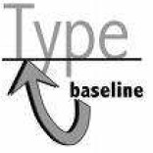
The vertical-align property
45
property | description
vertical-align | specifies where an inline element should be aligned vertically, with respect to other content on the same line within its block element's box
◻◻ can be top, middle, bottom, baseline (default), sub, super, text-top, text-bottom, or a length value or %
(baseline means aligned with bottom of non-hanging letters)

Slide 46
The display property
46
h2 { display: inline; background-color: yellow; }
CSS
output
property | description
display | sets the type of CSS box model an element is displayed with
◻◻ values: none, inline, block, run-in, compact, ...
◻◻ use sparingly, because it can radically alter the page layout

Slide 47

The display property
47
<ul id="topmenu"> <li>Item 1</li>
 | <li>Item <li>Item | 2</li> 3</li>
</ul> |  | HTML
#topmenu li {
display: inline;
border: 2px solid gray; margin-right: 1em;
}
CSS
output
◻◻ lists and other block elements can be displayed inline
◻◻ flow left-to-right on same line
◻◻ width is determined by content

Slide 48
The visibility property
48
p.secret {
visibility: hidden;
}
CSS
output
◻◻ hidden elements will still take up space onscreen, but will not be shown
¤ to make it not take up any space, set display to none instead
◻◻ can be used to show/hide dynamic HTML content on the page in response to events

Slide 49

Practice Time

Slide 50
Web Color codes:
Background of website: #f4f4f4;
Orange : #e8491d
Header background: #35424a

